Slide 1
Basic Calculator Using Python Tkinter
Manish vermA

Slide 2

agenda
Learn Python GUI development.
Understand Tkinter library.
Perform basic arithmetic operations.
Create a user-friendly calculator application

Slide 3

Technologies used:
Python 3.14
Tkinter Library
Visual Studio Code
Windows Operating System

Slide 4

Features of calculator:
✅ Addition (+)
✅ Subtraction (-)
✅ Multiplication (*)
✅ Division (/)
✅ Clear Button (C)
✅ Equal Button (=)
✅ Display Screen for Input and Output

Slide 5

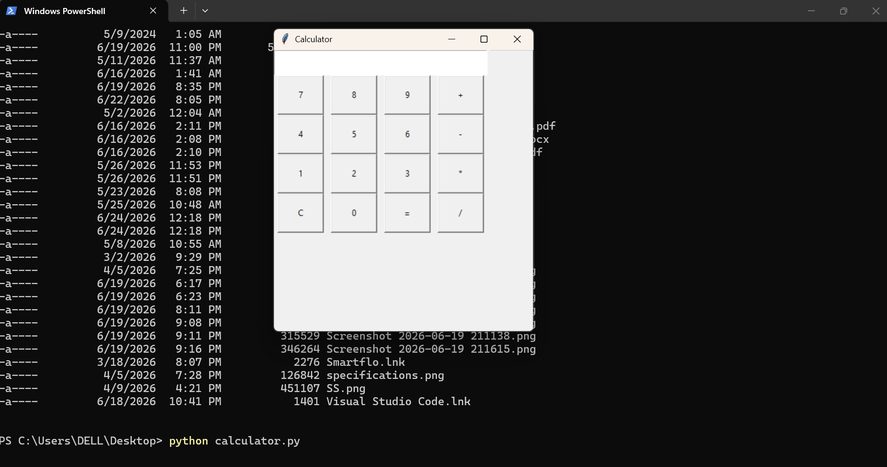
Output and conclusion:
Screenshot inserted-

Slide 6

Thank you

